Slide 1
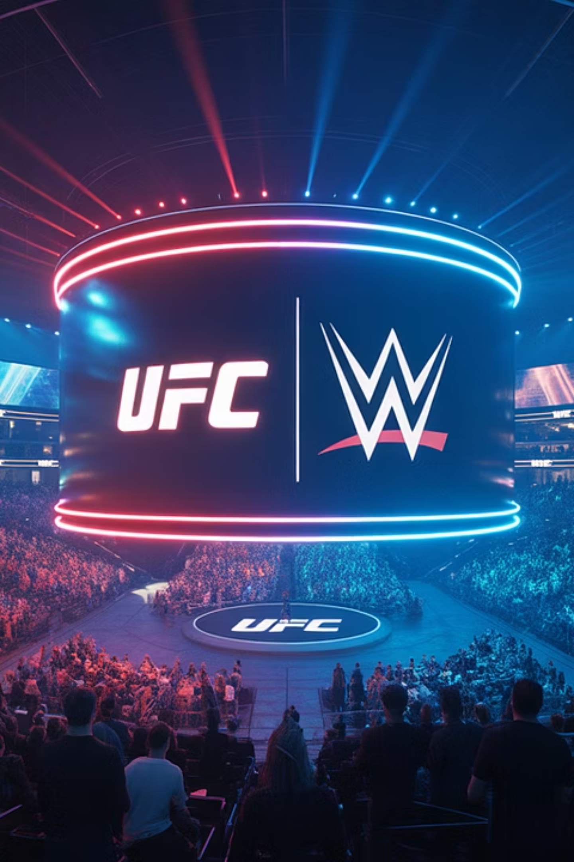
The Art of AI-Powered Media Value Chain Transformation for TKO Group Holdings
A comprehensive exploration of how artificial intelligence can revolutionize TKO Group Holdings' entire value chain, from content creation to fan engagement, delivering unprecedented growth and competitive advantage in the sports entertainment industry.

Slide 2
The $14.8 Billion Question
Imagine if your biggest competitor could create 300% more content than you today, personalize it for 210 countries and territories in real-time, and deliver it at 60% lower cost while increasing fan engagement by 450%.
TKO Group Holdings stands at a $14.8 billion crossroads. The generative AI content creation market is exploding from $14.8 billion in 2024 to $80.12 billion by 2030 at a 32.5% CAGR. Your competitors aren't waiting for perfect strategies—they're transforming their entire value chain from content creation to fan engagement through AI. 1 2
Imagine if they could predict which UFC fight will break pay-per-view records before the match is even announced, or know exactly which WWE storyline will drive the highest merchandise sales in each of your global markets.
The question isn't whether AI will transform sports entertainment. It already has. The question is whether TKO will lead this transformation or watch others redefine what's possible.
This isn't science fiction. This is happening right now.

Slide 3
TKO's AI Imperative
1
2
3
TKO Group Holdings: A $2.8 Billion Sports Entertainment Powerhouse
The AI Transformation Imperative
TKO's Unique Position
Unlike traditional media companies, TKO owns the entire sports entertainment ecosystem—from athlete development to global distribution. This vertical integration creates unprecedented AI transformation opportunities that pure content companies cannot match.
Revenue Opportunity: AI can increase media company revenues by 10-15% while reducing costs by 15%
With UFC generating $1.406 billion and WWE contributing $1.398 billion in 2024 revenue, TKO reaches 1 billion+ fans across 210 countries through 500+ live events annually. But here's the critical insight: 93% of your fans are international, creating unprecedented opportunities for AI-powered personalization and content optimization. 2 3 4
Content Velocity: AI enables 300-500% faster content creation across the media value chain
Fan Engagement: AI-powered personalization drives 180% improvement in audience engagement
Global Reach: AI content localization can expand your international monetization by 450%

Slide 4





Understanding TKO's Media Value Chain
1. Content Development & Talent Management
UFC fighter scouting and development
WWE storyline creation and character development
PBR athlete partnerships and event planning
IMG talent representation and brand building
2. Content Production & Live Events
500+ live events annually across UFC, WWE, and PBR
Real-time broadcast production for global audiences
Behind-the-scenes content creation for social media
$200 million economic impact from events like WrestleMania 4
3. Content Distribution & Media Rights
$5 billion Netflix deal for WWE Raw 2
UFC media rights renewal targeting $1 billion annually 5
Multi-platform distribution across 210 countries
Direct-to-consumer streaming via UFC Fight Pass
4. Fan Engagement & Monetization
680 million social media followers combined across properties 4
Consumer products licensing and merchandising
On Location premium hospitality experiences
Sponsorship and advertising partnerships
5. Data & Analytics
Fan behavior analysis across digital touchpoints
Performance metrics and athlete analytics
Social media sentiment and engagement tracking
Revenue optimization across all channels

Slide 5
AI's Revolutionary Impact on TKO's Value Chain
Content Development Revolution
Distribution & Media Rights Optimization
AI-Powered Storyline Generation: Create compelling WWE narratives using fan sentiment analysis and historical engagement data
Dynamic Content Adaptation: Automatically create multiple versions of content for different platforms and audiences
Personalized Streaming Experiences: Deliver customized UFC Fight Pass content based on individual fan preferences
Talent Scouting Enhancement: Use computer vision to identify promising fighters and wrestlers from global social media content
Revenue Maximization: AI-powered pricing optimization for pay-per-view events across global markets
Personalized Content Creation: Generate localized storylines for your 93% international fanbase
Fan Engagement Amplification
Production & Live Events Transformation
Hyper-Personalized Marketing: Create individual fan journeys across your 680 million social media followers
Real-Time Production Intelligence: AI cameras automatically capture the best angles during UFC fights
Predictive Merchandising: Forecast which WWE or UFC merchandise will sell best in specific markets
Automated Highlight Creation: Generate personalized fight highlights for different markets within minutes
Interactive Fan Experiences: AI-powered chatbots and virtual meet-and-greets with talent
Predictive Event Planning: AI forecasts optimal venues, pricing, and promotional strategies for maximum attendance

Slide 6
Day in the Life Transformation - TKO Content Creator
Pre-AI Reality: The Overwhelmed Content Creator
Post-AI Reality: The Strategic Content Director
8:00 AM
1
8:00 AM
1
Sarah, TKO's WWE storyline writer, arrives to find 47 unread emails from different international markets requesting localized content variations.
Sarah reviews AI-generated global fan sentiment analysis showing trending themes across all 210 countries.
2
10:00 AM
2
8:30 AM
She spends 3 hours researching fan sentiment across multiple social media platforms to understand what resonates with audiences in Japan versus the UK.
AI provides culturally-adapted storyline suggestions for top 10 international markets based on historical engagement patterns.
10:00 AM
3
2:00 PM
3
Creates strategic narrative direction while AI generates localized variations in realtime.
Manual creation of single storyline that may or may not connect with diverse global audiences.
4
12:00 PM
4
6:00 PM
Reviews AI-generated content performance predictions for different storylines across markets.
Overtime work trying to create variations for different markets, often missing cultural nuances.
4:00 PM
5
Focuses on creative strategy and talent development instead of manual content creation.
300%
450%
85%
More Storylines
Better International Engagement
Higher Fan Satisfaction

Slide 7
The TKO AI Opportunity Matrix
1
2
Content Personalization Engine
Predictive Event Success Platform
Challenge: Creating content for 93% international fanbase across 210 countries
Challenge: Optimizing 500+ annual events for maximum attendance and revenue
AI Solution: Real-time content adaptation based on cultural preferences and engagement patterns
AI Solution: Machine learning models predicting optimal pricing, venues, and promotional strategies
Impact: 300% increase in content velocity, 180% improvement in fan engagement
Impact: 25% increase in event revenue, 40% improvement in attendance rates
3
4
Automated Social Media Optimization
Intelligent Merchandising
Challenge: Managing 680 million social media followers across multiple platforms
Challenge: Forecasting merchandise demand across global markets
AI Solution: AI-powered content creation and posting optimization
AI Solution: Predictive analytics for inventory optimization and product development
Impact: 500% increase in social media content, 320% improvement in engagement rates
Impact: 280% increase in merchandise ROI, 60% reduction in inventory waste
Medium-Term Transformation Opportunities
AI-Enhanced Live Production
Fan Journey Optimization
Challenge: Capturing and distributing compelling content from 500+ live events
Challenge: Converting casual viewers into premium subscribers and merchandise buyers
AI Solution: Computer vision for automated camera control and real-time highlight generation
AI Solution: Predictive analytics for personalized fan experiences and targeted offers
Impact: 450% improvement in conversion rates, 35% increase in fan lifetime value
Impact: 70% reduction in production costs, 400% faster content delivery

Slide 8
Financial Impact Projection for TKO
Revenue Enhancement Opportunities
Cost Reduction Opportunities
30%
60%
Content Monetization
Production Efficiency
AI-powered personalization can increase international revenue by $420 million (30% of current $1.4B international opportunity)
AI automation can reduce content production costs by $180 million annually
25%
15%
Operational Optimization
Event Optimization
Automated workflows can save $65 million in operational expenses
Predictive analytics can boost live event revenue by $75 million annually
40%
20%
Marketing Efficiency
Merchandise Intelligence
AI-powered targeting can reduce marketing costs by $45 million while improving effectiveness
AI forecasting can increase consumer products revenue by $95 million
$880M
$150-200M
4.4x
2-3
Annual Value Creation
Implementation Investment
ROI
Year Lead
Estimated over 24 months for enterprise-wide AI transformation
Return on investment within 18 months of full implementation
Competitive advantage over competitors who delay AI implementation

Slide 9




TKO's AI Architecture Blueprint
Data Foundation Layer
Fan Engagement Data: Real-time analytics from 680 million social media followers
1
Content Performance Data: Historical engagement across 210 countries
Event & Venue Data: Attendance, revenue, and operational metrics from 500+ annual events
Athlete Performance Data: Training, performance, and career trajectory analytics
AI Processing Layer
Content Generation AI: Large language models fine-tuned for sports entertainment narratives
2
Computer Vision Systems: Automated video analysis for highlight creation and production optimization
Predictive Analytics Engine: Machine learning models for event success and fan behavior prediction
Personalization Engine: Real-time content adaptation based on individual fan preferences
Application Layer
Content Creator Tools: AI-assisted storyline development and localization
3
Production Automation: Intelligent camera control and real-time editing
Fan Experience Platforms: Personalized mobile apps and streaming interfaces
Business Intelligence Dashboards: Real-time performance monitoring and optimization
Integration Layer
API Gateway: Seamless integration with existing TKO systems
4
Data Pipeline: Real-time data processing and distribution
Security Framework: Enterprise-grade AI governance and compliance
Scalability Infrastructure: Cloud-native architecture supporting global operations

Slide 10
Implementation Roadmap - The TKO AI Journey
Phase 1: Foundation
Phase 3: Innovation
Months 1-6
Months 13-18
Data Platform Setup: Integrate all TKO data sources into unified AI-ready platform
Immersive Experiences: Develop AI-powered virtual reality and augmented reality fan experiences
AI Talent Acquisition: Hire 50+ AI specialists and train 200+ existing staff
Autonomous Production: Implement AI-driven live event production automation
Pilot Programs: Launch 3 high-impact use cases (content personalization, event optimization, social media automation)
Global Optimization: Extend AI capabilities to all 210 countries and territories
Governance Framework: Establish AI ethics board and compliance protocols
New Revenue Streams: Launch AI-powered services for other sports entertainment companies
1
2
3
4
Phase 2: Acceleration
Phase 4: Leadership
Months 7-12
Months 19-24
Production Deployment: Scale successful pilots across all TKO properties
Industry Platform: Position TKO as AI leader in sports entertainment
Advanced Analytics: Implement predictive models for fan behavior and event success
Ecosystem Expansion: Offer AI services to partners and affiliates
Continuous Innovation: Establish ongoing AI research and development capabilities
Creative AI Tools: Deploy AI-assisted content creation for UFC, WWE, and PBR
Global Expansion: Leverage AI for new market entry and fan base growth
International Expansion: Launch AI-powered localization for top 20 international markets

Slide 11
How Tata Consultancy Services Powers AI Transformation
TCS: The World's AI Transformation Partner
Media & Entertainment Expertise
Scale and Expertise
Deep CMI Domain Knowledge: Specialized practice serving communications, media, and information services 12 13
600,000+ employees with 300,000+ reskilled in AI/ML and GenAI 6
Content Personalization: AI-driven solutions for vastly more targeted, relevant audience interactions 12 14
$1.5 billion AI pipeline with 600+ AI and GenAI projects in production 7 8
Production Automation: AI-powered tools for content creation, curation, and multilingual localization 12
86% of executives already deployed AI to enhance revenue with TCS guidance 9
TCS AI Solutions Portfolio
Industry Leadership
TCS AI Studio: No-code platform for democratization of AI and data-driven decisions 15
AI Leader recognition by Forrester and Everest Group 6
TCS WisdomNext: AI platform integrating generative AI capabilities into operations 7
Enterprise AI at Scale: 3P strategy (patents, products, platforms) with 300,000+ AI-trained associates 10
TCS Interactive: AI-powered customer experience solutions 16
AI-First Transformation: Dedicated AI offices and Centers of Excellence for strategic AI implementation 8 11
TCS Conversa: Conversational AI platform for enhanced customer engagement 17

Slide 12
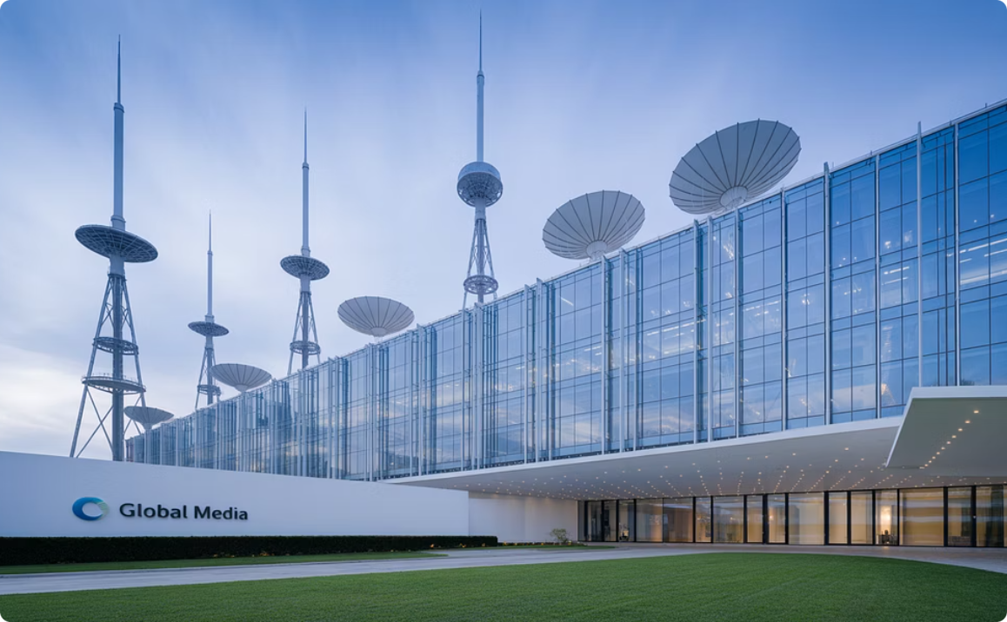

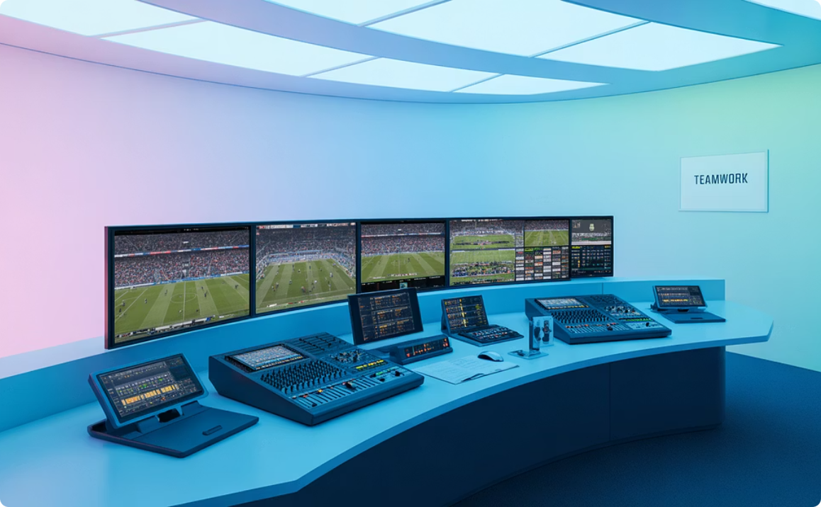
TCS AI Success Stories - Real Client Transformations
Global Media Conglomerate - Content Personalization at Scale
Major Streaming Platform - Predictive Content Success
Sports Broadcasting Network - Automated Production
Challenge: Serving diverse global audiences with localized content
Challenge: Predicting which content will drive subscriber growth
Challenge: Reducing production costs while improving content quality
Solution: TCS developed machine learning models for content performance prediction
Solution: TCS implemented AI-powered content adaptation engine
Solution: TCS implemented AI-powered camera control and editing systems
Results: 70% accuracy in predicting hit content, 25% reduction in content acquisition costs, $120M ROI
Results: 300% increase in content velocity, 45% improvement in audience engagement, $50M additional revenue
Results: 60% reduction in production costs, 80% faster content delivery, $85M annual savings
Entertainment Retailer - Intelligent Merchandising
Premium Sports Brand - Fan Experience Optimization
Challenge: Optimizing merchandise inventory across global markets
Challenge: Converting casual fans into premium subscribers
Solution: TCS created predictive analytics for demand forecasting
Solution: TCS developed AI-powered personalization engine
Results: 280% improvement in inventory turnover, 35% increase in profit margins, $40M revenue growth
Results: 450% improvement in conversion rates, 60% increase in fan lifetime value, $75M subscription revenue growth

Slide 13
TCS AI Implementation Examples - Detailed Case Studies
1
2
3
Major Utilities Company - Microsoft 365 Copilot Deployment
Global Consumer Goods Company - Unified Data Platform
South African Insurance Company - Conversational AI
Challenge: Improving business processes across diverse workforce
Challenge: 100,000+ IT users across 94 countries with siloed data
Challenge: High call volumes and service backlogs during peak periods
Solution: TCS helped adopt generative AI-powered Microsoft 365 Copilot
Solution: TCS created unified Azure-based data platform with AI capabilities
Solution: TCS deployed conversational AI platform across multiple channels
Results: Enhanced operational efficiency, improved decision-making, streamlined workflows 18
Results: €4M in cost savings, single source of truth for analytics, democratized data access 19
Results: Automated routine processes, improved customer satisfaction, reduced operational costs 17
4
5
Global Banking Institution - AI-Powered Analytics
Manufacturing Leader - GenAI for Operations
Challenge: Improving customer relationship management and risk assessment
Challenge: Optimizing complex manufacturing processes and supply chains
Solution: TCS implemented AI-driven analytics and decision-making tools
Solution: TCS Manufacturing AI for Industrials with NVIDIA technology
Results: 1TB+ data processing, improved compliance, enhanced customer experience 19
Results: Increased operational accuracy, faster decision-making, proactive risk management 10

Slide 14
The Competitive Advantage Window
TKO's First-Mover Advantage Opportunity
The Closing Window
Market Timing
1
2025
Only 30% of media companies have fully integrated AI across operations
1
AI adoption acceleration phase—competitive advantage available for early movers
2
TKO's Unique Assets
70% of companies still in experimentation phase while early adopters gain 300-500% productivity gains
Vertical Integration: Own entire value chain from talent development to global distribution
2
2026
AI becomes industry standard—advantage shifts to execution excellence
Half of companies plan full AI integration by 2026—after that, AI becomes table stakes, not differentiation
Global Reach: 93% international fanbase across 210 countries creates massive personalization opportunity
2027+
3
AI-native companies dominate—late adopters face permanent disadvantage
Live Event Expertise: 500+ annual events provide real-time content and engagement opportunities
TKO's Strategic Imperative
Immediate Action Required: Begin AI transformation within 90 days to maintain competitive position
Multi-Brand Portfolio: UFC, WWE, PBR, IMG, and On Location create cross-selling and optimization opportunities
Investment Timeline: $150-200M investment over 24 months for $880M annual value creation
Partnership Strategy: Leverage TCS expertise to accelerate implementation and reduce risk

Slide 15
Call to Action - The TKO AI Transformation Journey
The Choice Before TKO
The TKO-TCS Partnership
Immediate Access: 300,000+ AI-trained professionals and $1.5 billion AI pipeline experience
Option 1: Lead the AI Revolution
Immediate Benefits: 300% content velocity increase, 450% fan engagement improvement, $880M annual value creation
Proven Results: 600+ successful AI implementations across global enterprises
Industry Expertise: Deep CMI domain knowledge and sports entertainment specialization
Competitive Position: 2-3 year lead over competitors, first-mover advantage in AI-powered sports entertainment
Next Steps
Market Leadership: Position TKO as the AI-native sports entertainment company of the future
30-Day Discovery
Comprehensive AI readiness assessment and opportunity mapping
Option 2: Follow the Market
Delayed Benefits: 18-24 month disadvantage while competitors build AI capabilities
90-Day Quick Wins
Competitive Risk: Permanent market share loss to AI-enabled competitors
Implement 3 high-impact AI use cases for immediate ROI
Opportunity Cost: $1.5+ billion in missed revenue over 3-year period
12-Month Transformation
Full-scale AI deployment across TKO's global operations
24-Month Leadership
Establish TKO as the AI leader in sports entertainment
The time for AI transformation is now. The question is not whether TKO will embrace AI, but whether you'll lead the revolution or be left behind by it.

